Slide 1
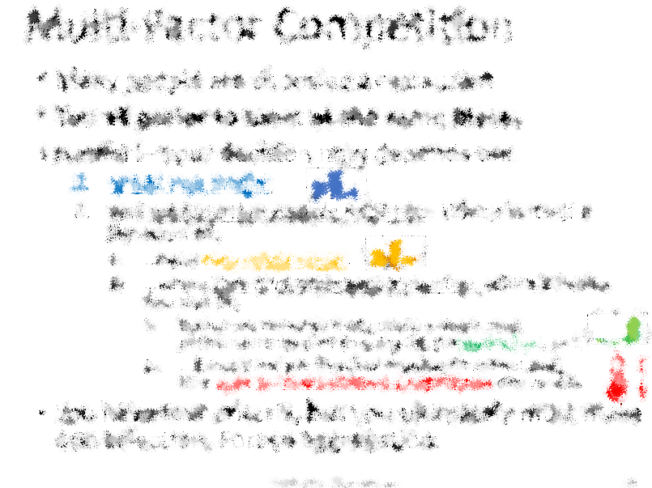
Bitcoin Hivemind
The important thing is to establish a political climate of opinion which will make it politically profitable for the wrong people to do the right thing.”
― Milton Friedman
TAB Conf, Atlanta, GA
Paul Sztorc
1/27/2018
BitcoinHivemind.com
@BitcoinHivemind
Version 1.1 2/13/2018

Slide 2
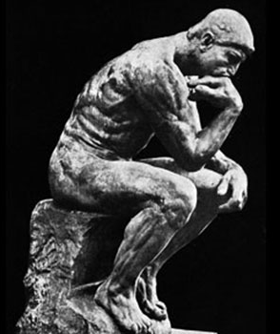
Overview
This talk is about the problem which Hivemind solves,
it is not about how Hivemind works .
www.BitcoinHivemind.com
Hivemind is about “Governance”, defined as group decision-making.
Governance has problems – namely rational ignorance and preference aggregation, and these problems can be solved with conditional prediction markets.
This is a passion project of mine, I hope you enjoy!
Enforced Group
Policy

Slide 3
Agenda
Moral Objections to Governance (Speech)
How Society Reacts to Problems (An Analogy)
Why Governance is Hard (A Diagnosis)
What Prediction Markets Are (An Institution)
Blockchain Conditional Prediction Markets – Solution to Governance
Getting Practical

Slide 4
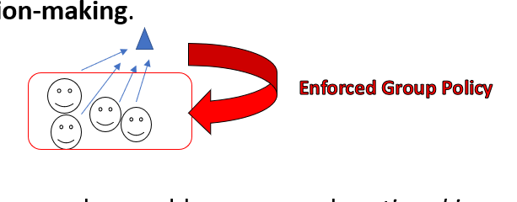
Moral Objection to Governance
Observation: Undesirable to have a decision forced on you. (Might be one you dislike.)
Policy: Individual should always have a pure veto (even on pre-agreed rules); or rather: consent can/should never be estimated.
I don’t agree with the Policy:
Efficient cooperation → better life
Ad hominem fallacy
“consent of the governed”
extreme
“all contracts are coercive”, naïve anarchy
“social contract”
Notes:
And hence the process doesn’t really exist.

Slide 5
1 – Efficiency / Wasting Resources
Some things are much easier to buy/maintain as a group. Marginal utility of “individualism” rapidly diminishes as we approach “100% individualism”.
“One Person Ruins it for Everyone” ( de facto Entangled )
Outcome is an “OR” aggregation process, already
Ozone Layer / The Montreal Protocol (no competing Earths)
(Hypothetical) Grey Goo – self replicating nanotechnology that kills us all
Pollution / Externalities
Overfishing / Species Extinction
Extremely ‘contagious’ spread of fire / disease / looting.
Efficient “re-use” of goods/services.
The roads (infamous) and highways; National parks
Walls/Castles -- (4x vs x^2), strangers vs friends/family, trust issues
The Erie Canal, Louisiana Purchase, Interstate Highway System,
Basic science research (ie, its hard for Newton to patent “Gravity”)
Excessive market transaction costs – too hard to charge “per time per individual”
Ronald Coase – Theory of the Firm; organizations vs markets – to difficult to rehire people every day for every job, costs: search, contract, negotiation etc. Long term contracts are better.
Roads again (excl bridges, trains);
Long time horizon, not enough ink
“However attractive anarchy may be as a philosophy, it is not feasible in a world of imperfect men.” – Milton Friedman
Notes:
Tradeoff – efficient to sacrifice some individualism for greater happiness / survival of our species.

Slide 6
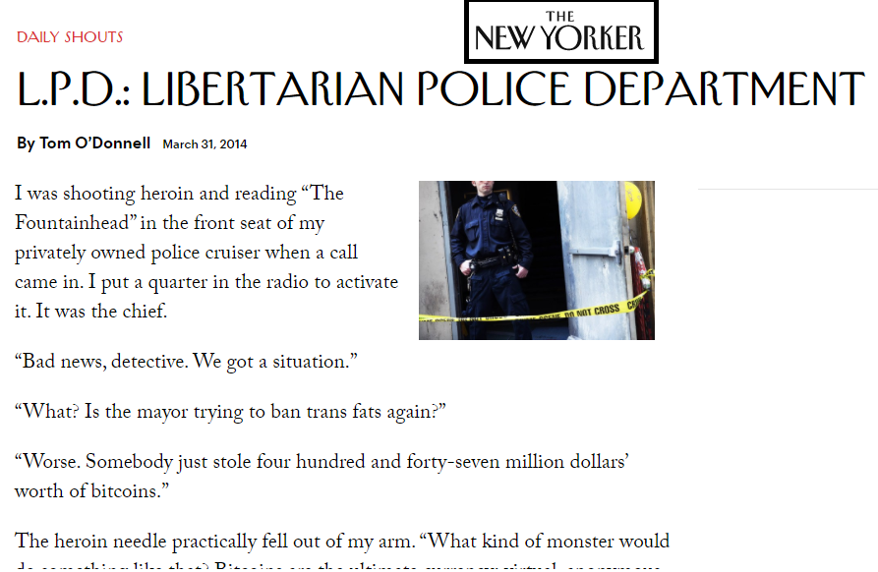
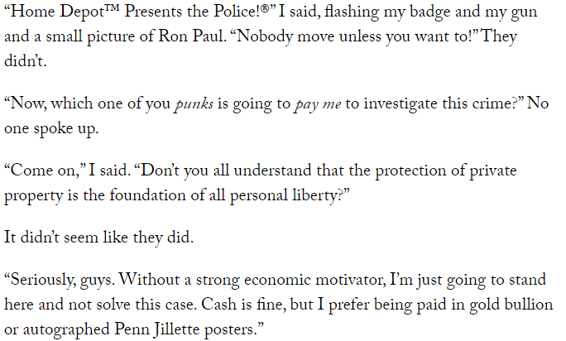
1 – Efficiency / Wasting Resources
Some things are much easier to buy/maintain as a group. Marginal utility of “individualism” rapidly diminishes as we approach “100% individualism”.
“One Person Ruins it for Everyone” ( de facto Entangled )
Outcome is an “OR” aggregation process, already
Ozone Layer / The Montreal Protocol (no competing Earths)
(Hypothetical) Grey Goo – self replicating nanotechnology that kills us all
Pollution / Externalities
Overfishing / Species Extinction
Extremely ‘contagious’ spread of fire / disease / looting.
Efficient “re-use” of goods/services.
The roads (infamous) and highways; National parks
Walls/Castles -- (4x vs x^2), strangers vs friends/family, trust issues
The Erie Canal, Louisiana Purchase, Interstate Highway System,
Basic science research (ie, its hard for Newton to patent “Gravity”)
Excessive market transaction costs – too hard to charge “per time per individual”
Ronald Coase – Theory of the Firm; organizations vs markets – to difficult to rehire people every day for every job, costs: search, contract, negotiation etc. Long term contracts are better.
Roads again (excl bridges, trains);
Long time horizon, not enough ink
“However attractive anarchy may be as a philosophy, it is not feasible in a world of imperfect men.” – Milton Friedman
Notes:
Tradeoff – efficient to sacrifice some individualism for greater happiness / survival of our species.

Slide 7
2 – Ad Hominem
All of the –isms, including Anarchism, are ad hominem fallacies.
Karl Popper “Open society and its enemies”
The wrong question (Who should rule?)
What process moves us from bad policies to better ones at the cheapest cost. What is ‘most profitable’ process dBenefit/Cost/time. (Not “who is most trustworthy?” –error, temporary, manipulable).
Image: people → policy → result
The important thing is the policy, not who put it there.
You order / spouse orders / lucky guess → grilled chicken sandwich ordered for $10 → you eat the sandwich and pay $10. It is fungible – identical in every sense. In fact, if you give your order to the waitress, she’s going to pass it on to the chef anyway.
Obviously, if you are in control, policies will always be good for you. But remember the “Or” scenarios on the previous slide.
Merely finding the best policies is useless. NEED a Meta-Policy to know how to get to the best policies from here, and ensure we don’t go backwards once we get there. Without it, anarchism is as impractical as pacifism.

Slide 8
3 – Consent of the Governed
Voluntarism = interactions should be voluntary
Declaration of Independence // Post-Enlightenment governments
“We hold these truths to be self-evident, that all men are created equal, that they are endowed by their Creator with certain unalienable Rights, that among these are Life, Liberty and the pursuit of Happiness. — That to secure these rights, Governments are instituted among Men, deriving their just powers from the consent of the governed”
So, USA is 100% voluntarist …at least in intent.
AnCaps – you can hire security guards (if you explicitly agree), but “taxation is theft”. Need to ask, can’t assume.

Slide 9
3 – All Knowledge is Imperfect (incl. Consent)
Worst case -- no direct knowledge -- House MD example
Best case – still can never be 100% certain of consent
Are they under mysterious duress that we’ve failed to detect?
Hiring security guard = racketeering?
Was the consent informed? To what extent?
Can ‘consent’ be revoked at any time?
Misunderstandings / miscommunications?
So, it isn’t always as simple as “asking”…
Unable to speak / perform computation – unconscious
No time to ask (object would prefer that we didn’t wait) – choking to death, imminent cataclysm
Ruins “the experience” – Surprise party!
…or even as “listening”.
Multiple selves across time – (“I don’t want to practice the piano”) – alarm clock, going to the gym, going to school, saving money, severe drug addiction – self as group.
Brainwashed / preferences hacked – (“I love going to church”) – peer pressure, too young (0-10 yrs old), outright deception.
Ruins “the experience” – roller coaster, S&M club – thrill is inability to escape.
(is a nation state a roller coaster, sometimes it feels like one.. sometimes it feels like an S&M club)
My view: consent is always conjectured (imperfectly estimated). So the fact that we have to estimate “group consent” is not logical a deal-breaker.

Slide 10
The “Public” Sector
Fractal nature of the “public / private” distinction:
“Public” refrigerator for 30th floor East of NYC Goldman Sach’s building – “etiquette”
“public roads”, “public schools” in Cleveland and Connecticut
Competing nation-states; states as “laboratories of democracy”
anarchist brain cancer.
Only the individual experiences pain, pleasure, creativity, and will. But this says nothing about how to maximize individual well-being.
“There are some problems that can’t be solved outside of the political arena” – Peter Thiel

Slide 11
Where we are
Past Slides
Governance: group decision-making.
Governance = important, some problems can only be solved with governance.
Even on the extreme, if we know that “X-ism is the best”, we need a tool for taking us from here to X-ism, and for keeping us at X-ism in a dynamic improving world.
Governance can be ethical – question is: does government have the consent of the governed? Can we improve tools for measuring/alerting us to consent-errors.
Coming Up
Ignoring, Tolerating, and Solving Problems – A rain metaphor
Governance is hard. Why?
What are prediction markets?
What are conditional prediction markets?

Slide 12
Problems – Rejecting, Tolerating, and Solving
Rejecting a Problem
Misunderstanding/misrecognizing the problem.
Ceremonial use of problem as backdrop, for social reasons.
Tolerating a Problem
You know there is a problem, you know there is currently no solution. Problem may seem unsolvable.
Problem is accepted an unalterable fact of life.
Solving a Problem
You know the problem, and the solution.
You will have obtained more knowledge and better technology, and the problem will depart, never to return.

Slide 13
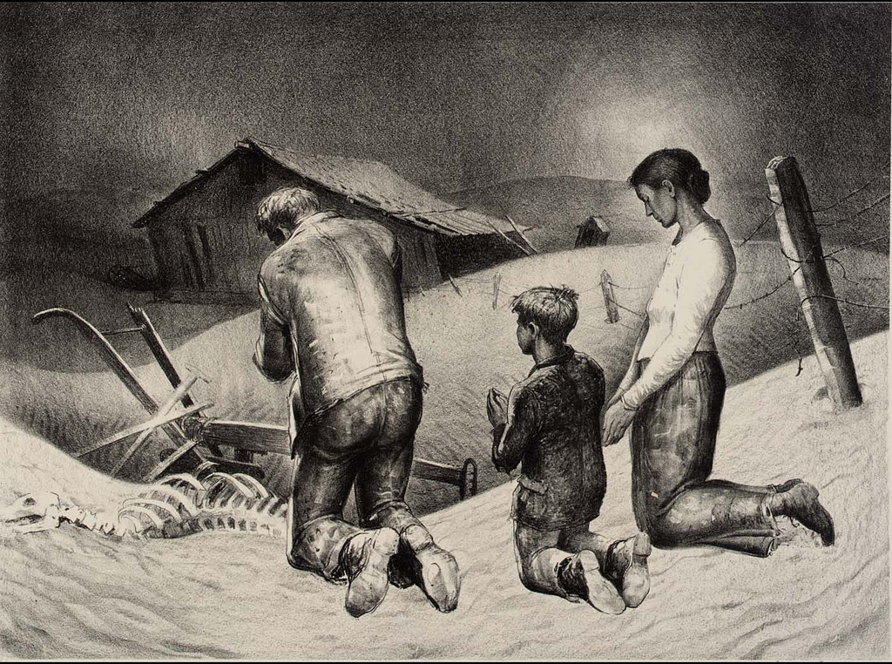
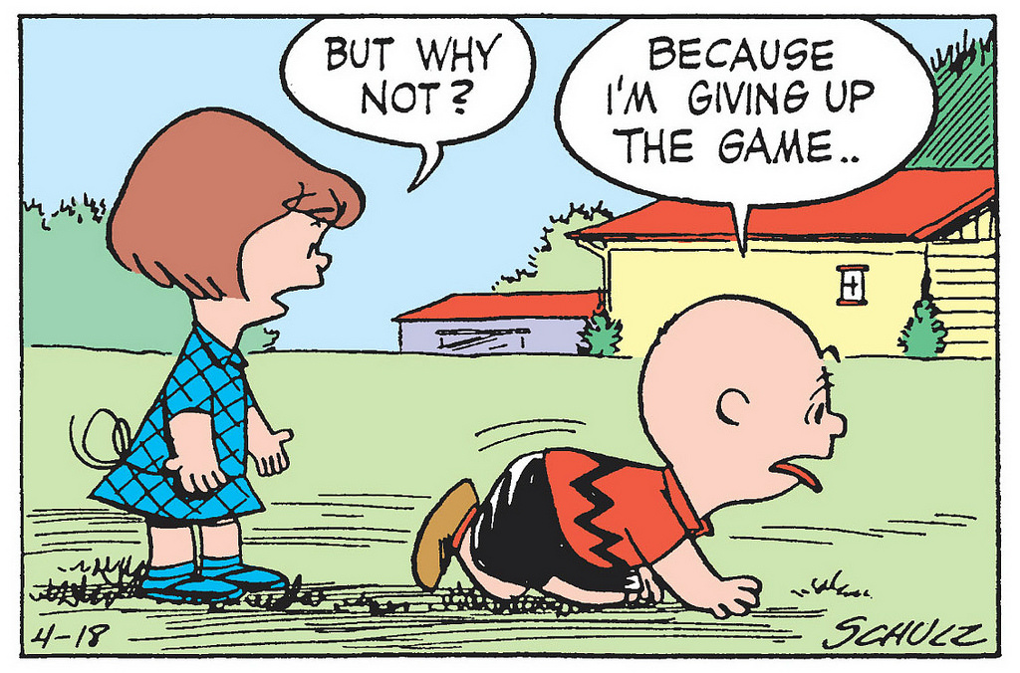
Ex: No Rain, Bad Harvest
Pray more – [do nothing to get more rain]
Try to reject the problem, or erroneously respond – the critical thing is prayer, not water.
Use false solution as opportunity for socialization (ie ‘signaling’ or ‘loud complaining done to make friends’).
Culture may eventually rely on these false solutions, for stability.
Settle for Failure – [accept that “rain is unreliable” is unalterably true]
Accept reality and make the best of it.
Other options: ration more; have fewer children / livestock; give up on agriculture (hunt instead); plant many more seeds to overcompensate for the eventual loss (work harder).
Irrigation Technology – [solve the problem]
…using more knowledge, and better technology.
Allen, Praying for Rain (1938)
Schulz, Peanuts (1954)
Notes:
This problem, of how to make sure you would get enough rain,
and have enough food to eat,
dominated people’s minds, their hopes and fears,
for tens of thousands of years, if not longer.
But today we don’t even think about it.

Slide 14
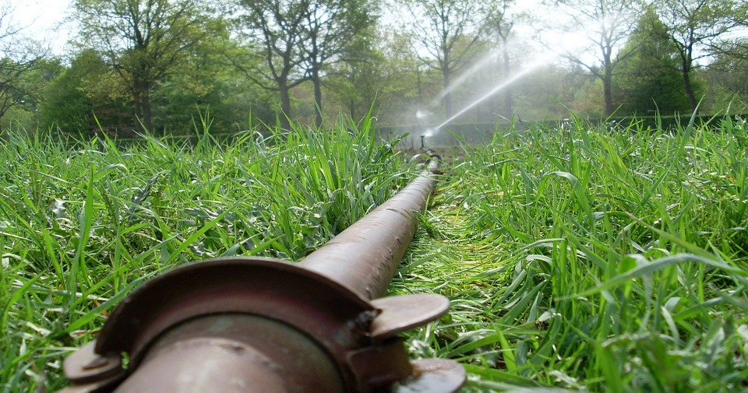
Ex: No Rain, Bad Harvest
Pray more – [do nothing to get more rain]
Try to reject the problem, or erroneously respond – the critical thing is prayer, not water.
Use false solution as opportunity for socialization (ie ‘signaling’ or ‘loud complaining done to make friends’).
Culture may eventually rely on these false solutions.
Settle for Failure – [accept that “rain is unreliable” is unalterably true]
Accept reality and make the best of it.
Other options: ration more; have fewer children / livestock; give up on agriculture (hunt instead); plant many more seeds to overcompensate for the risk (work harder).
Irrigation Technology – [solve the problem]
…using more knowledge, and better technology.
Allen, Praying for Rain (1938)
Schulz, Peanuts (1954)
Notes:
This problem, of how to make sure you would get enough rain,
and have enough food to eat,
dominated people’s minds, their hopes and fears,
for tens of thousands of years, if not longer.
But today we don’t even think about it.
( Unless you live in California )

Slide 15
Problems – Rejecting, Tolerating, and Solving
Rejecting a Problem
Misunderstanding/misrecognizing the problem.
Ceremonial use of problem for social reasons.
Tolerating a Problem
Recognizing that a problem exists – knowing that there is currently no solution, and why. Problem may seem unsolvable.
You will grit your teeth and accept this as an unalterable fact of life -- reaching an equilibrium with the problem.
Solving a Problem
Understanding the problem, solution is better ideas/tech.
You will have obtained more knowledge, and the problem will depart, never to return.
Anarchism / Voluntarism /
Voting Ron Paul
The Cypherpunks / Encryption / Bitcoin
Blockchain Conditional Prediction Markets

Slide 16
Governance is Hard. Why?
If everyone is doing the wrong thing, why can’t we just get everyone to stop doing that, and do something else?
Answer: Multi-Factor Competition
Costly Negotiation
Too many ‘other things’ to do
High cost of miscoordination
Notes:
US Constitution – best parts of the government are non-governance: judicial branch, the enumerated powers, Bill of Rights.
Power to the people – estimate consent with voting – elections (for people) and referendums (for amendments).

Slide 17
Single-Factor Competition
You want to spend up to $20 on dinner.
You are choosing (and dining) alone.
Expected satisfaction by spending <=$20 at the given restaurant
Restaurant A
Restaurant B
Restaurant C

Slide 18
Single-Factor Competition
You want to spend up to $20 on dinner.
You are choosing (and dining) alone.
Expected satisfaction by spending <=$20 at the given restaurant
Restaurant A
Restaurant B
Restaurant C
You get the highest satisfaction possible.
Restaurants induced to compete on (satisfaction / $).

Slide 19

Multi-Factor Competition
Many people are choosing a restaurant
You all prefer to meet at the same place.
Harder!– your decision now depends on:
What you prefer,
and where other people might go. Which is itself a function of:
...what they might prefer.
…where they think other people might go. Which is itself a function of:
Everyone’s collective best guess on where most people currently plan on going (ie, the status quo), and,
… (since time/attention/communication are not free) how open to communication / negotiation everyone is.
You have four criteria, but you ultimately must make one selection. Forced aggregation.
Notes:
Self-fulfilling prophecy -- If many believe that “negotiating to pick a better restaurant is a lost cause”, then they will not be open to negotiation.
Negotiation is especially hard when there are [1] many people, and [2] many alternatives. In USA there are ~250 Million adults, and a near-infinite number of potential policies.

Slide 20
Multi-Factor Competition
Many people are choosing a restaurant
You all prefer to meet at the same place.
Harder!– your decision now depends on:
What you prefer,
and where other people might go. Which is itself a function of:
...what they might prefer.
…where they think other people might go. Which is itself a function of:
Everyone’s collective best guess on where most people currently plan on going (ie, the status quo), and,
… (since time/attention/communication are not free) how open to communication / negotiation everyone is.
You have four criteria, but you ultimately must make one selection. Forced aggregation.
Self-fulfilling prophecy – Those who believe that “negotiating to pick a better restaurant is a lost cause”, will be less open to negotiation. Circular truth.
Negotiation is especially hard when there are [1] many people, and [2] many alternatives. In USA there are ~250 Million adults, and a near-infinite number of potential policies. In these cases the prophecy is likely to self-fulfill (lost cause).

Slide 21
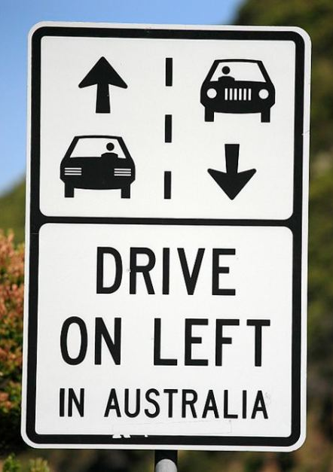
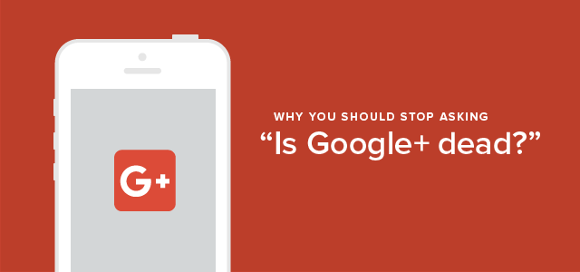
Multi-Factor Competition
The root cause in the restaurant example, “wanting to stay in sync with others” is a common desire.
Coordination reduces ambiguity / conflict.
Network effects / economies of scale.
Competing w/ Facebook or Craigslist …vs w/ local barber shop.

Slide 22
Multi-Factor Competition
The problem is real, and it has nothing to do with “coercion” and can’t be explained with moral arguments.
Most people will put up with Facebook, even though FB is “evil”. Because the alternatives are :
[1] no Facebook (and social isolation), or
[2] and endless (and ultimately futile) negotiation with unmotivated friends/family to switch to one particular alternative (among many). They would then need to convince their own friends, who would need to convince their own friends, and so on and so forth…
In the same way, we put up with governments, even though they are incompetent. The alternatives are:
[1] no government and no property rights (a disaster), or
[2] an uncertain, potentially endless, potentially violent transition period, leading to an ambiguous final outcome.
The root cause in the restaurant example, “wanting to stay in sync with others” is a common desire.
Coordination reduces ambiguity / conflict.
Network effects / economies of scale.
Competing w/ Facebook or Craigslist …vs w/ local barber shop.

Slide 23
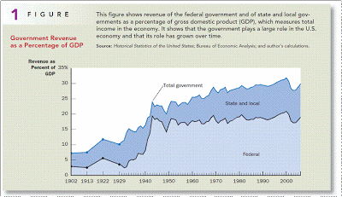
Multi-Factor Competition
Pumping up that second factor, with a CRISIS!!
“…while these crises [Great Depression, WW2] were transitory, the increase in the scope of government was permanent.”
Bad policies following crises:
1929 Crash → Taxes/tariffs, labor cartels
WW2 → Japanese Internment Camps
9/11/2001 → Iraq War / PATRIOT Act
2008 Crash → Bailouts, Retroactive Bonus Financing
The problem is real, and it has nothing to do with “coercion” and can’t be explained with moral arguments.
Most people will put up with Facebook, even though FB is “evil”. Because the alternatives are :
[1] no Facebook (and social isolation), or
[2] and endless (and ultimately futile) negotiation with unmotivated friends/family to switch to one particular alternative (among many). They would then need to convince their own friends, who would need to convince their own friends, and so on and so forth…
In the same way, we put up with governments, even though they are incompetent. The alternatives are:
[1] no government and no property rights (a disaster), or
[2] an uncertain, potentially endless, potentially violent transition period, leading to an ambiguous final outcome.
The root cause in the restaurant example, “wanting to stay in sync with others” is a common desire.
Coordination reduces ambiguity / conflict.
Network effects / economies of scale.
Competing w/ Facebook or Craigslist …vs w/ local barber shop.

Slide 24
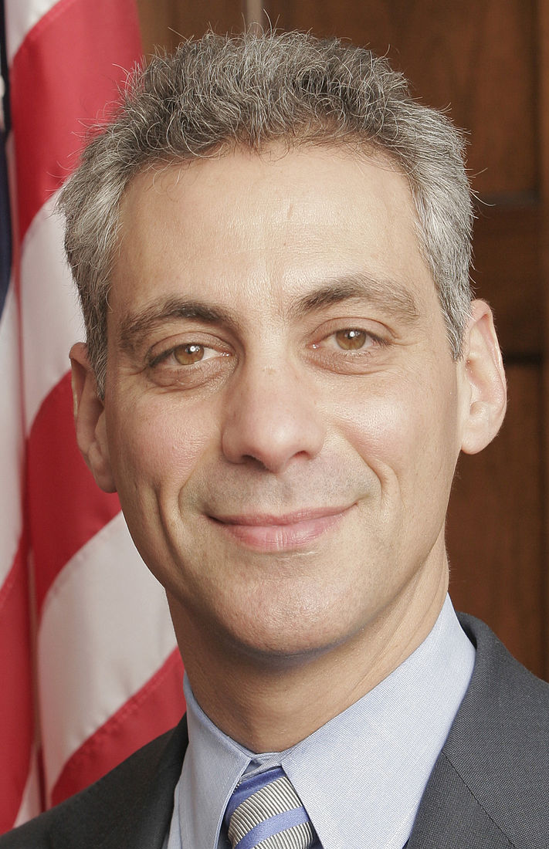
Multi-Factor Competition
Pumping up that second factor, with a CRISIS!!
“…while these crises [Great Depression, WW2] were transitory, the increase in the scope of government was permanent.”
Bad policies following crises:
1929 Crash → Taxes/tariffs, labor cartels
WW2 → Japanese Internment Camps
9/11/2001 → Iraq War / PATRIOT Act
2008 Crash → Bailouts, Retroactive Bonus Financing
The problem is real, and it has nothing to do with “coercion” and can’t be explained with moral arguments.
Most people will put up with Facebook, even though FB is “evil”. Because the alternatives are :
[1] no Facebook (and social isolation), or
[2] and endless (and ultimately futile) negotiation with unmotivated friends/family to switch to one particular alternative (among many). They would then need to convince their own friends, who would need to convince their own friends, and so on and so forth…
In the same way, we put up with governments, even though they are incompetent. The alternatives are:
[1] no government and no property rights (a disaster), or
[2] an uncertain, potentially endless, potentially violent transition period, leading to an ambiguous final outcome.
The root cause in the restaurant example, “wanting to stay in sync with others” is a common desire.
Coordination reduces ambiguity / conflict.
Network effects / economies of scale.
Competing w/ Facebook or Craigslist …vs w/ local barber shop.
“You don’t ever want to let a crisis go to waste: It’s an opportunity to do important things you would otherwise avoid.” - Rahm Emanuel (WH Chief of Staff under Barack Obama), speaking in 2008

Slide 25

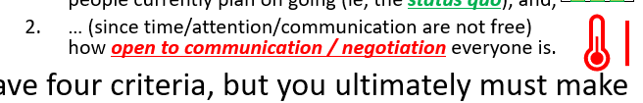
Multi-Factor Competition
Pumping up that second factor, with a CRISIS!!
“…while these crises [Great Depression, WW2] were transitory, the increase in the scope of government was permanent.”
Bad policies following crises:
1929 Crash → Taxes/tariffs, labor cartels
WW2 → Japanese Internment Camps
9/11/2001 → Iraq War / PATRIOT Act
2008 Crash → Bailouts, Retroactive Bonus Financing
The problem is real, and it has nothing to do with “coercion” and can’t be explained with moral arguments.
Most people will put up with Facebook, even though FB is “evil”. Because the alternatives are :
[1] no Facebook (and social isolation), or
[2] and endless (and ultimately futile) negotiation with unmotivated friends/family to switch to one particular alternative (among many). They would then need to convince their own friends, who would need to convince their own friends, and so on and so forth…
In the same way, we put up with governments, even though they are incompetent. The alternatives are:
[1] no government and no property rights (a disaster), or
[2] an uncertain, potentially endless, potentially violent transition period, leading to an ambiguous final outcome.
The root cause in the restaurant example, “wanting to stay in sync with others” is a common desire.
Coordination reduces ambiguity / conflict.
Network effects / economies of scale.
Competing w/ Facebook or Craigslist …vs w/ local barber shop.
“You don’t ever want to let a crisis go to waste: It’s an opportunity to do important things you would otherwise avoid.” - Rahm Emanuel (WH Chief of Staff under Barack Obama), speaking in 2008
Crisis Logic
In times of crisis:
Mis-coordination costs RISE !
Anyone interfering with coordination is dangerous!
Thus, the defenses of the Status Quo greatly increase.

Slide 26
Voting – Your Civic Duty
Knowledge Cost – too high
existing option , the challenger, both plans, likelihood of follow-through, and effect of these plans on you.
Effect is a complex topic. For some policies, only ultra-specialists know.
71% of Americans can’t even name their Congressional Representative (Delli-Carpini and Keeter (1997)),
let alone the challenger or any proposed policies or voting records (or any State Senators, etc).
Story: Lobbyists on a Plane

Slide 27
Voting – Multifactor-ness of “Electability”
Arrow impossibility result: voting = paradox
While you have more than one voter, and a deterministic aggregation process (technicalities), you can only have one of the following two:
Pareto efficiency – you can’t hurt an option when everyone ranks it higher
Irrelevant alternatives really are irrelevant – you can’t hurt an option by re-ranking the set of options below or above it. Stalin vs Hitler.
Arrow’s result leads to strategic voting
If Jeb Bush had run, would have split the vote
When vote is split, votes cast for a ‘lost cause’ do not contribute at all to The Battle that really matters.
Electability – knowledge that other people believe that this choice is not a lost cause. (Same as the restaurant example.)
Hence political parties / media have great influence.

Slide 28
To Solve Governance, We Need:
A cheap, reliable source of information on who to vote for.
A way of crunching the multi-factorness, specifically electability, back into a single factor.
A way of preventing capture of the above processes by lobbyists/cronies.

Slide 29
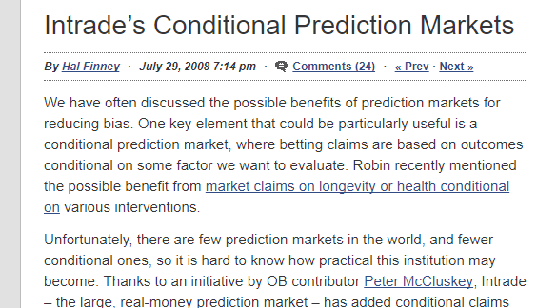
Bitcoin Hivemind
Sidechain for P2P Prediction Markets
“There are only a few people alive today worth listening to. Robin Hanson is one of them.”
– Ralph Merkle, co-inventor of asymmetric (public/private) key cryptography, inventor of cryptographic hashing, and of the Merkle tree.

Slide 30
Agenda
Moral Objections to Governance (Speech)
How Society Reacts to Problems (An Analogy)
Why Governance is Hard (A Diagnosis)
What Prediction Markets Are (An Institution)
Blockchain Conditional Prediction Markets – Solution to Governance
Getting Practical

Slide 31
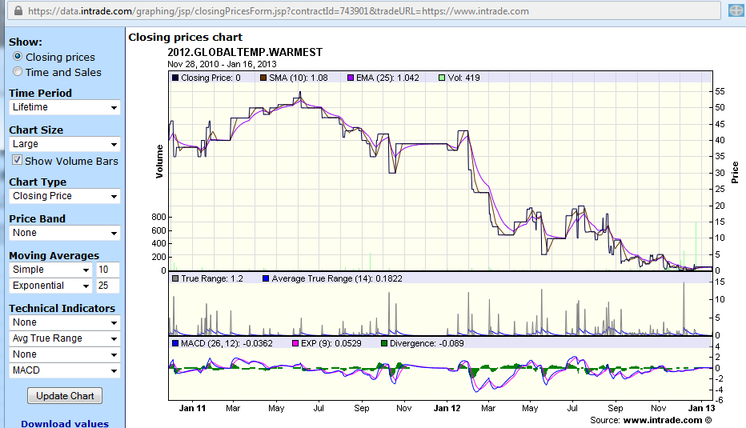
A ‘prediction market’ is a special kind of derivative. Below: event derivative (InTrade.com) on 2012 global warming
Worth $100 if 2012 is the warmest year on record.
Ran from Jan 2011 to End of 2012

Slide 32
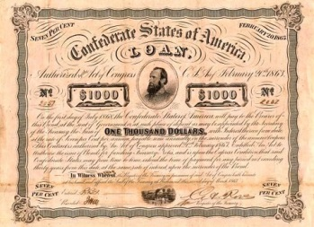
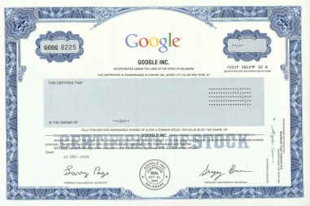
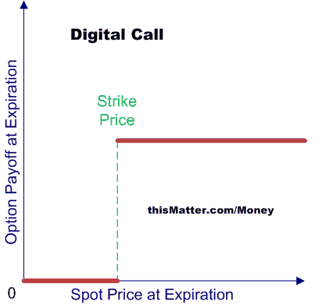

Event Derivatives
Finance Thing | Interpretation
Bond (Debt) | “I, Paul Sztorc, owe $20 to whoever is holding this bond certificate on 03/02/2015.”
Stock (Equity) | “I, the CEO of SztorcCorp, owe 1/100th of SztorcCorp’s profits to whoever is holding this stock certificate on 03/02/2015.”
Binary Call Option | “I, Paul Sztorc, owe $20 to whoever is holding this Option on 03/02/2015, only if the stock price of SztorcCorp is above 40 $/share on that date.”
…(others)… | …(others)…
Event Derivative | “I, Paul Sztorc, owe $20 to whoever is holding this derivative on 12/01/2016, only if Hillary Clinton is elected US President in 2016. Otherwise I owe $0.”
…(others)… | …(others)…
Notes:
Change Forward to Binary Stock Derivative or something.

Slide 33
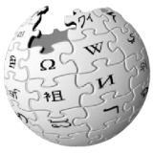

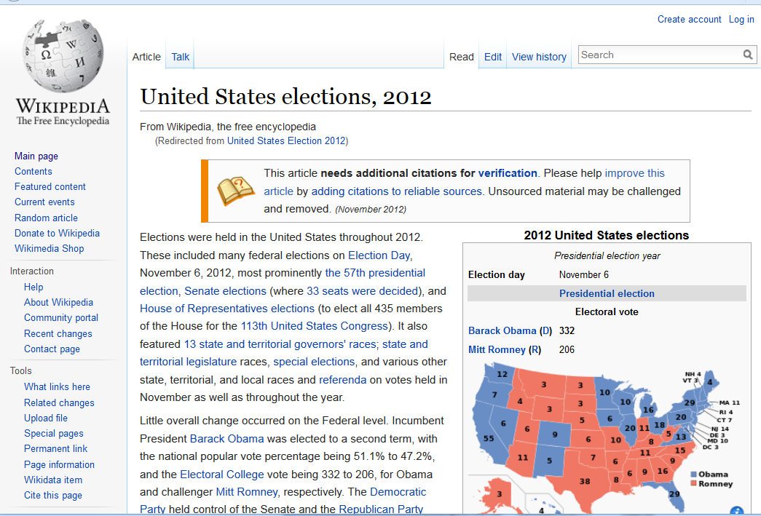
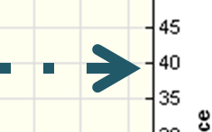
A Kind of “Future Wikipedia”
 | Wikipedia | Truthcoin
Focus | Outcomes of past events. Consensus on known facts. | Outcomes of future events. Future consensus on knowable facts.
Cost | Free to read and edit. | Free to read, easy to understand (check prices), but edits can cost or earn you money.
Learn, in Jan 2011, how unlikely it was that 2012 would be warmest.
Already Happened
Price=40 implies 40%

Slide 34

Markets Aggregate Information
For the Public: Reliable and Common Information
Does all of the Research for us, and the Persuading!
It’s broadcast to everyone (and everyone knows that everyone got it).
It’s right.
?
= Info Source
= Prediction Market
Notes:
Empiricism (do real world observations agree with this data source) as easily as checking the weather or score to a game.
Have to do a lot of work to learn something, but, because of the benefits of deception, you can’t easily share what you’ve learned.
Everyone knows not to be gullible, so we have to check others’ work. People can not-believe-you if you’re right, or they can believe you if you’re wrong. Every step degrades the quality of the signal. Most people don’t have the time to solve either of these problems. On the off-chance that climate change actually is fake or something, this software would be the only possible way of that message getting out. Given the way CO2 has always worked everywhere, I won’t hold my breath.

Slide 35
Benefits of PMs (Over Talking)
Talk: Why even bother becoming informed?
Hard to learn this stuff (and I only have so much time)
How am I supposed to convince others?
Info-processing is difficult (why résumés must be short).
Minimal-info strategies (join a tribe/“political party”).
PM forces a clear definition.
Prices are constantly and unanimously acceptable. At all times, everyone agrees with the price (if not, they can profitably trade).
Note: Suppose climate change were false. The “reliability” and “broadcast” problems are much worse.
Notes:
Torrential stream of lies by our blatantly corrupt federal government have now made it basically impossible to have a conversation about climate change. Nietzche: insidiousness via false support P

Slide 36
Agenda
Moral Objections to Governance (Speech)
How Society Reacts to Problems (An Analogy)
Why Governance is Hard (A Diagnosis)
What Prediction Markets Are (An Institution)
Blockchain Conditional Prediction Markets – Solution to Governance
Getting Practical

Slide 37
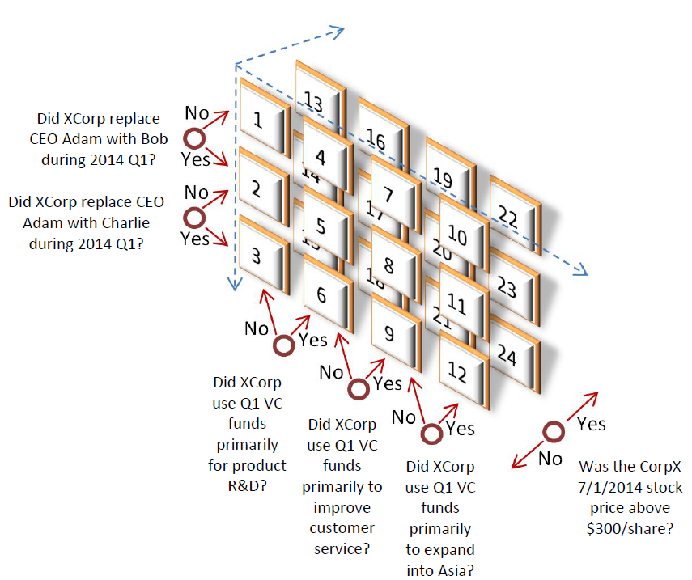
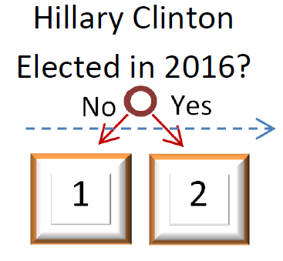
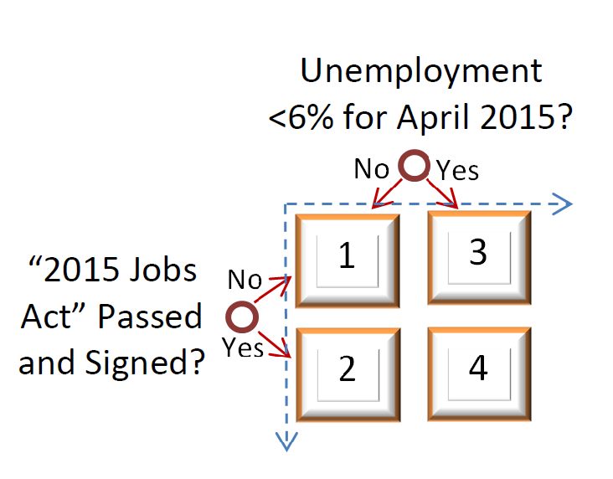
Conditional Forecasts: More Than One Dimension
3
1
2

Slide 38
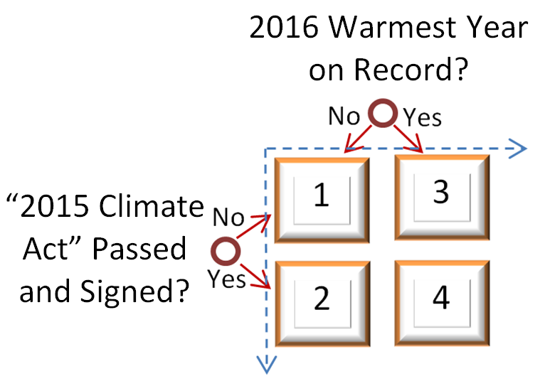
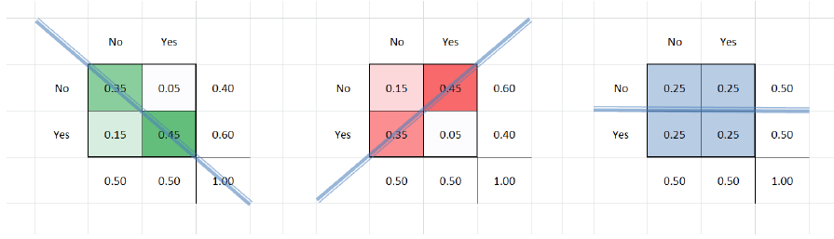
More Dimensions: More Forecasts, AND More Relationships
Joint, Marginal, and Conditional Probabilities
MSRs Bayesian Net
The Point: Probabilities are not only: “Will X happen?”…
…they are also: “Would Y influence X?”
Notes:
Could conceivably

Slide 39
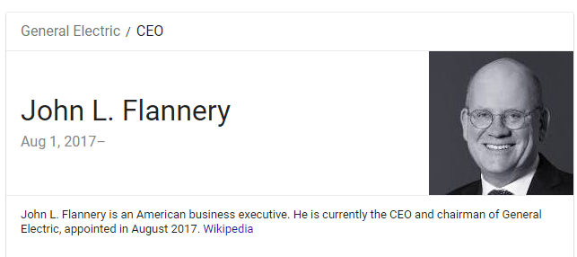
Example – Which CEOs aren’t pulling their weight?
How do we tell??
Problem of Agency Cost

Slide 40
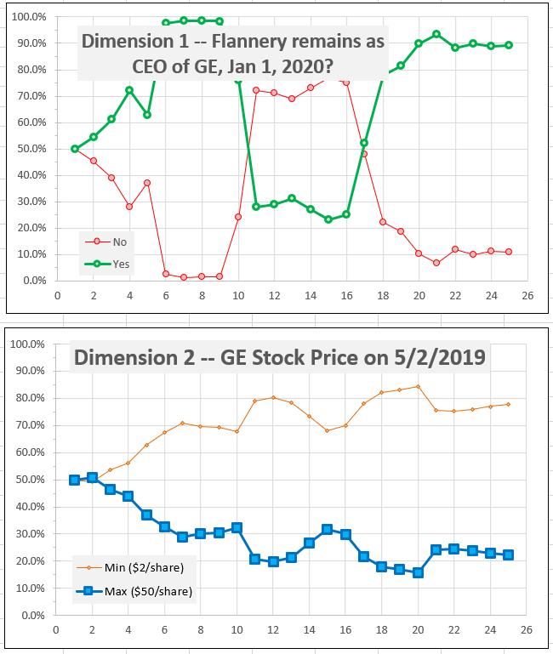
Two Individual Markets…
Mirroring (superfluous data)
Because Pr(Yes) = 1 – Pr(No)
But not for long…
Binary: Yes vs No
Scaled: Min vs Max
GE is having a rough year!
Is the CEO departing? Will he be fired? Should he be?
Notes:
Stock price declining from 26 toward 2.
50% splits the 48 range perfectly → 24, plus minimum of 2.

Slide 41
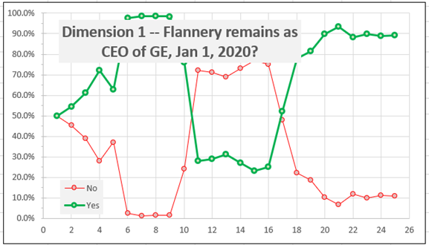
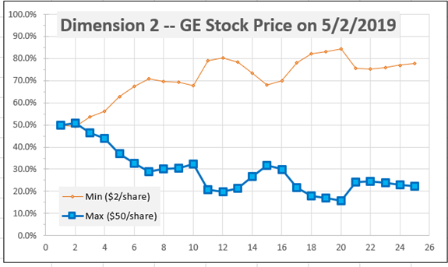
Exact same data…
CEO Staying?
Stock Price
Stock Price?
1+3 = green line
CEO Staying?
Marginal numbers
1+2 = blue line

Slide 42
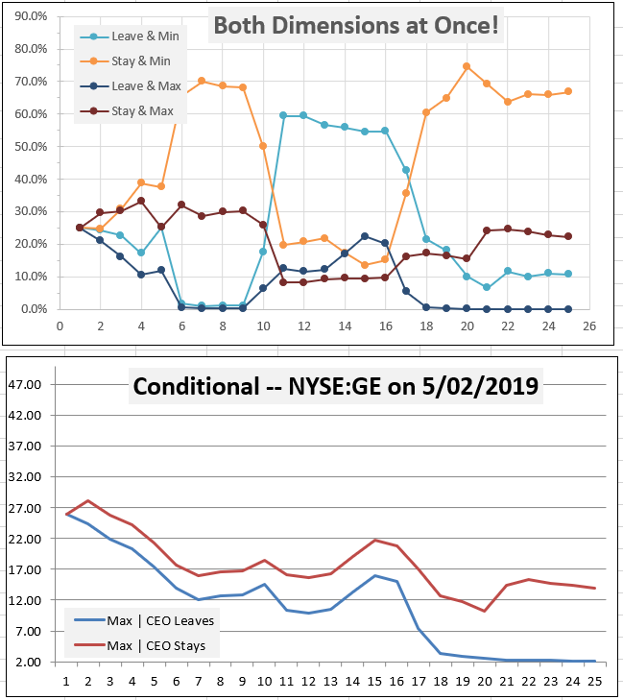
Four Dimensions at once, different “mirroring”
Same Data
Deleted 2 lines (of 4).
(Stay & Max) / Stay
(Leave & Max) / Leave
Scaled y-axis to $/share.
Now: only measures GE’s Stock Price

Slide 43
Forecasting the future stock price…
Four Dimensions at once, different “mirroring”
Same Data
Today’s estimate of what it will be.
Deleted 2 lines (of 4).
(Stay & Max) / Stay
(Leave & Max) / Leave
Scaled y-axis to $/share.
Now: only measures GE’s Stock Price
Past estimates of what it would be.

Slide 44
Important Questions: 1. Should the CEO be fired, or get a raise?
2. Why are both forecasts of “the future stock price” going down?
3. [extra credit] If I had instead graphed “ CEO Leaves | Max ” and “ CEO Stays | Min ”, what would those lines represent?
Four Dimensions at once, different “mirroring”
Same Data
Deleted 2 lines (of 4).
(Stay & Max) / Stay
(Leave & Max) / Leave
Scaled y-axis to $/share.
Now: only measures GE’s Stock Price
Notes:
Answers:
1. CEO should get a raise. Market consistently backs him. Most importantly, it is backing him right now! The most important thing is the recent measurement. 2. Because today’s price has been going down. + EMH
3. Would take the implied causality and reverse it. Here we say that CEO causes the stock price to change, but in that example we would be arguing something like “if the stock price skyrockets, how likely is the CEO to leave (perhaps, by quitting)”. The Y-axis would be 0% 100%, Yes/No

Slide 45
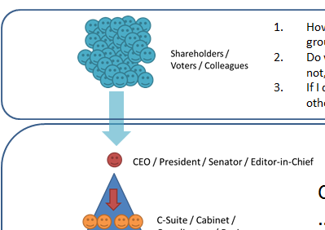
PM Governance
Applications
“Which CEO would most increase our stock price?”
“Which President would most decrease unemployment?”
“Which FED Policy would most increase GDP?”
“Which law would most decrease violent crime?”

Slide 46
We need
?
A cheap, reliable source of information on who to vote for.
A way of crunching the multi-factorness, specifically electability, back into a single factor.
A way of preventing capture of the above processes by lobbyists/cronies.

Slide 47
Multidimensionality can reverse the Multi-factor effects of Electability
“Good Economy” in 2021
( <5% Unemployment )?
Yes
No
Someone Else
0.0005 | 0.0005 | 0.001
.61 | .00 | .61
.38 | .00 | .38
.00 | .009 | .009
.9905 | .0095
Nov 2020 Election Winner
Democrat
Republican
Elon Musk
Musk unlikely to win, 0.9%, “Lost Cause”
Notes:
Could conceivably

Slide 48
Multidimensionality can reverse the Multi-factor effects of Electability
“Good Economy” in 2021
( <5% Unemployment )?
Conditional Likelihood of Good Economy
Yes
No
Someone Else
0.0005 | 0.0005 | 0.001
.61 | .00 | .61
.38 | .00 | .38
.00 | .009 | .009
.9905 | .0095
50%
0%
0%
100%
Nov 2020 Election Winner
Democrat
Republican
Elon Musk
Notes:
Could conceivably

Slide 49
Multidimensionality can reverse the Multi-factor effects of Electability
Election hasn’t happened yet…
Conditional Likelihood of Good Economy
Likelihood of Winning
Someone Else
00.1%
61.0%
38.0%
00.9%
50%
0%
0%
100%
Nov 2020 Election Winner
Democrat
Republican
Elon Musk
And everyone knows it…
Notes:
Could conceivably

Slide 50

Multidimensionality can reverse the Multi-factor effects of Electability
Election hasn’t happened yet…
Conditional Likelihood of Good Economy
Likelihood of Winning
Someone Else
00.1%
61.0%
38.0%
00.9%
50%
0%
0%
100%
Nov 2020 Election Winner
Democrat
Republican
Elon Musk
And everyone knows it…
Voter
Notes:
Could conceivably

Slide 51
Multidimensionality can reverse the Multi-factor effects of Electability
Conditional Likelihood of Good Economy
Likelihood of Winning
Immediate, cheap, tacit re-negotiation to elect this guy.
Someone Else
00.1%
61.0%
38.0%
00.9%
50%
0%
0%
100%
Nov 2020 Election Winner
Democrat
Republican
Elon Musk
Especially for uninformed or angry voters – the less they know, the better. The more they are confounded by media/ads, the better!
Notes:
Could conceivably

Slide 52
We have returned to Single-Factor Competition!
Conditional Likelihood of Good Economy
Someone Else
50%
0%
0%
100%
Nov 2020 Election Winner
Democrat
Republican
Elon Musk
100%
Notes:
Could conceivably

Slide 53
Agenda
Moral Objections to Governance (Speech)
How Society Reacts to Problems (An Analogy)
Why Governance is Hard (A Diagnosis)
What Prediction Markets Are (An Institution)
Blockchain Conditional Prediction Markets – Solution to Governance
Getting Practical (2 slides)

Slide 54
How to convince people that the PM information is reliable and interesting?
Ramp it up over time – Popular Things – Sports (SuperBowl, March Madness), Arts (Oscars, Tonys)
Accuracy will remain high, and that people gradually become interested.
The election process is so broken, and distasteful (ie, attack ads), that people will come around eventually.
Keep up the pressure each election year. Aim especially for Congressional elections where impact is high, voters least informed.

Slide 55
The Joy Index – a talk for another time
What do measure?
How to measure it safely, without that being gamed?
Randomness – un-gameable (“Sortition”)
Non-attribution, secret ballots

Slide 56
Thank You!
Questions?

Slide 57
Augur
Ethereum in General
No engineer takes it seriously.
“ActiveX of blockchain” – Austin Hill ;
Used for endless MLM pyramid scheme of ERC20 token.
Proof of stake = amateurs.
Theoretically Unsound
Liquid vs Cumulative trust – bad blockchain application
Still no use-cases – CryptoKiddies and TheDAO.
Unstable and constantly changing – DAO, hard fork, PoS.
Monetary policy is ultimately uncompetitive.
Eventually killed by Sidechains
Ethereum vs Blockchain Prediction Markets Specifically
Parasite contracts – Augur Rep value = cash flows from trading fees, but it is always possible to make contracts which undercut the fees (see my QCon talk last March). In sidechains (drivechains) such parasites are impossible. This is an unfixable design flaw in Ethereum.
Endless gas recalibrations (vs no gas at all, in sidechain case). Eth forces you to manage what other people say your node costs are (vs what your users decide they are).
Team is Incompetent
Augur guys found me in April 2014, while I was working full time.
They kept screwing everything up.
Somehow they still haven’t launched ??? We were mostly finished in 2015.
“Silicon Valley” / “startup” mindset which is incorrect and inappropriate. (T-shirts, promotional videos w/ famous people, ‘marketing’)
Clearly hadn’t read the whitepaper. Inane comments.
I would like nothing more than to have some competent group of people take over this project. I would love to let someone else be the Gavin Andresen. Better for decentralization and for the project.
Bad Leadership -- “Leaders Eat Last”
Raised money *before* starting work on the project.
Then, immediately a lot of people paid themselves large salaries and quit!
Zach Hess (screwed)
Tony Skaich

Slide 58
Gnosis

Slide 59
Other Applications
Wherever there is group decision-making
Corporations – would firing the CEO improve the stock price.
Obviously the CEO will not be too keen on running this experiment – just ask Dr. Robin Hanson, he has tried for years and years.

Slide 60
More on Anarchism/Voluntarism
Some say: no policies at all / public sector should not exist (or does not legitimately exist).
But this merely moves the problem from ‘government’ to ‘something else’. Some ingenious entrepreneur will have to solve it.
The critical issue is competition – when it is easy to switch ‘providers’, life is good; when it is hard to switch, life is worse.

Slide 61
Some Strange Decisions Recently
Public sector
Looming entitlement megacrisis
Un-repayable National Debt
Over-regulation: healthcare and education highly regulated → competition throttled, absurdly overexpensive. Exceptions prove the rule: cosmetic surgery / CVS, and Google/Wikipedia/Wolfram/SocMedia.
$5 trillion in M.E. wars, when it was promised that $50 billion would be enough.
NSA Spying / Net Neutrality – people dislike, esp experts, but it happens anyway.
Existence of Lobbying / Complex Tax Structure / Earmarks – Tax Reform would create tremendous wealth for everyone.
Financial Crisis reaction – allowing Lehman to fail AND then bailing everyone out.
Contrast with: Louisiana Purchase, Erie Canal, Edison-era Patents, Golden Gate Bridge (3.5yrs, 7 AR), Pasteurized/Fortified Milk, WW2 Total War, Manhattan Project, Marshall Plan, Eisenhower Interstate Project, DARPA/Pre-Internet, The Apollo Program
Wages flat for 40 years, Energy more expensive over 40 year
Private sector
CEO Pay / golden parachutes / poison pill
Financial crisis – passing off reckless loan, bizarre incentive structures (compensated in short-term cash bonuses, despite long-term consequences), shareholders didn’t care.

Slide 62
Civic Duty Part Two
Need to know all representatives, their policies, the likelihood that these policies will actually be put into place at all, the effect of these policies on you,
Quadruple threat: best ideas (more knowledge), *persuasive* explanations of the idea, *likelihood* of follow through, AND most electable.
As the world becomes more complex, it is less likely that your neighbor understands the issues. As his likelihood of understanding the issues falls, the whole thing becomes a prisoner’s dilemma and Rational Ignorance.
Majority of voters don’t have the ability to find the ‘right’ answer
So, it becomes a heuristic game – what *can* I collaborate with these other people on. Result: issues must be simple and obvious.

Slide 63
Elections over Time
Demonstration
Graph of “cost of assessing representative”, recognition line, assessment line, corruption zone, dissatisfaction zone.
Assessment (name:[policy:]effect of at least two competitors).
Story about WY Representative and Lobbyists on a plane!

Slide 64
Elections Over Time 2
A simpler time – less technological progress, less scientific knowledge, smaller economy, less specialization (*many* farmers) = simpler problems.
Fewer Distractions
Media – typography, telegraph, radio
Lincoln-Douglas debates – 90 minutes, most people stop watching in the first few minutes (?), 60 second statement, 30 second rebuttal, pivoting / no one even remembers the content.

Slide 65
What we need
Something that will identify the best ideas…
…and communicate them to us…
…

Slide 66
Blockchain Prediction Markets
What they are
The important issues.
…
Always right in two senses – focus on easily-verifiable events, EMH

Slide 67
…

Slide 68
X -- Governance is Important
Some things it is easier to do as a coordinated group.
Image: group decisions vs individual decisions.
Why not let ‘the market’ do it? Maybe some entrepreneur will come up with something -- well, that’s what this project is about!
Should we even *do* anything?
Anarchist view is that we should go on vacation to Anarchapulco once a year and complain loudly to each other, but otherwise do nothing to prevent/reverse the spread of bad policies.

